Slide 1
Parmar heena 2327
Topic:-Artificial intelligence

Slide 2
contents of AI
Introduction
Defination
Early History of AI
Types
Application of AI
Example of AI
Advantages & disadvantages

Slide 3
Introduction
Artificial Intelligence is a method of making a computer, a computer-controlled robot, or a software think intelligently like the human mind.
AI is accomplished by studying the patterns of the human brain and by analyzing the cognitive process. The outcome of these studies develops intelligent software and systems.

Slide 4
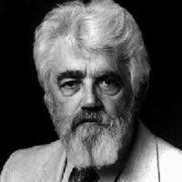
Defination
Artificial Intelligence (AI), a term coined by. emeritus Stanford Professor John McCarthy in 1955, was defined by him as “the science and engineering of making intelligent machines”.

Slide 5
Early History of AI
1950: Alan Turing published “Computer Machinery and Intelligence” which proposed a test of machine intelligence called The Imitation Game.
1952: A computer scientist named Arthur Samuel developed a program to play checkers, which is the first to ever learn the game independently.

Slide 6
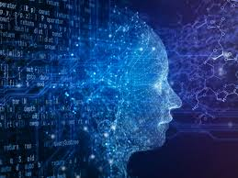
Types
Narrow AI
general AI
super AI

Slide 7
Application of AI
Application in E-commerce
Application in Education
Application in life-cycle
Application in Health care
Application in social media
Application in marketing
Application in cyber security
Many more…

Slide 8
Example of AI
ChatGPT
Google Maps
Smart Assistants
Snap chat Filters
Self-Driving Cars

Slide 9
Advantages & disadvantages
Advantages
disadvantages
Zero Risks
24*7 Availability
Daily application
Reduction in human error
fast decision making
High costs of creation
Making human crazy
Make human lazy
Emotionless
Feelings

Slide 10
THANK YOU

